Slide 1
BUSSINESS REPORT
- By Yash Sundli

Slide 2
Answer 1
In Question 1 it was asked to generate summary statistics for each variable and state your observations .
Firstly I adjusted the data and converted the average price into whole numbers as it was not and that may give the wrong output .
I created the summary statistics for each variable by using Data Analysis tool pack .

Slide 3
Observation -
In the summary statistics we can see that Average Price and Tax have slightly higher standard deviation among all the other variables .
It simply means that the data is volatile . Also volatile in variables like Age , Indus , LSTAT and Distance . All variables with high standard deviations are highlighted .
As for the other variables like NOX , Average Room , Pt ratio and Crime rate has a lower standard deviation it means that the data of those variables is not much volatile Stable data .

Slide 4
.
We can also see that all of the variables are having skewness and only one of the variable is having a negative skewness PT Ratio .
Skewness just means that there are outliers in our data .
We can also see negative kurtosis in some variables Crime Rate , Age , Indus , Distance , Nox .
Also in crime rate we can observe that there is not much of a difference in mean and median unlike the other variables

Slide 5
Answer 2
In this Question it was asked to Plot a Histogram of Average Price variable .
After plotting the Histogram it is observed that the data is not a symmetrical it is an asymmetrical data and we can see that it is making a positive skew as it is trailing off to the right
The data is positively Skewed

Slide 6
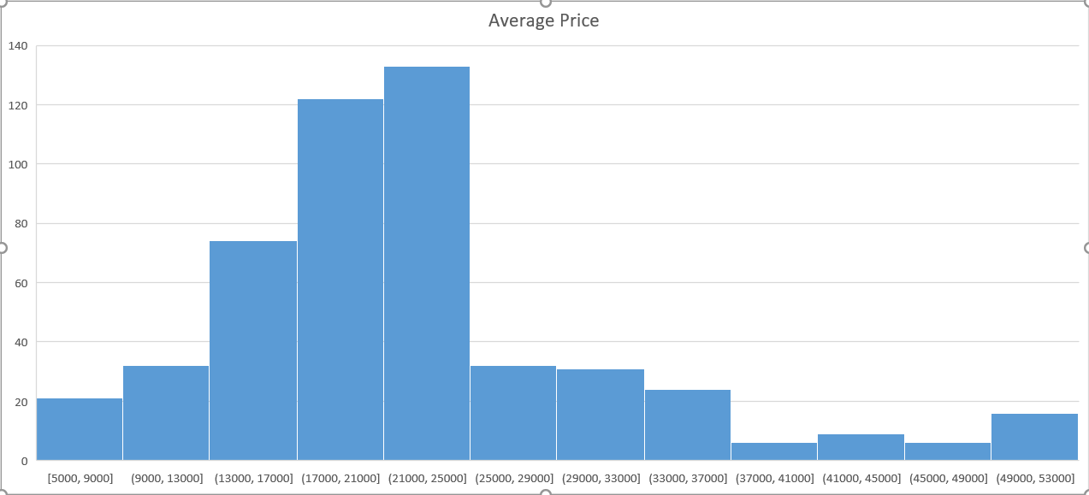
Average Price Histogram -

Slide 7
Answer 3 -
In Question 3 it was asked to create a Covariance Matrix
After computing the covariance matrix we can see that all variables except crime rate are having negative covariance with Average price .
All the negative covariance are highlighted .

Slide 8
Answer 4
In Question 4 it was asked to create correlation matrix and then state the top 3 positively correlated pairs and t0p 3 negatively correlated pairs .
After using the Data analytics tool to compute the correlation matrix I used conditional formatting to easily identify the top 3 negatively and positively correlated pairs as they are now highlighted .
Top 3 Positively correlated pairs –
1. Tax vs Distance (0.91)
2. NOX vs Indus (0.76)
3. NOX vs AGE (0.73)

Slide 9
.
Top 3 Negatively correlated Pairs –
1. Average Price VS LSTAT (-0.74)
2. LSTAT VS Average Room (-0.61)
3. Average Price VS PT Ratio (-0.51)
All of the require values are highlighted.

Slide 10
Answer 5 -
In Question 5 it was asked to Build an initial regression model with AVG_PRICE as ‘y’ (Dependent variable) and LSTAT variable as Independent Variable. Generate the residual plot .
What do you infer from the regression summary output –
Firstly we can see that the value of Multiple R is 0.74 that means
there is a correlation of 0.74 between the variables .
As for the R square the value is 0.54 that means only 54% of variation in the average price can be explained by LSTAT .

Slide 11
.
0.54 value of R Square is not that good but it is acceptable .
Coefficient Value is -950.05 (Negative Value) This simply means that lower the LSTAT more would be the average price according to this model .
Intercept is 34553.84
As for the residual plot in that we can see that most of the residuals are lying on the line but some of them are scattered. There is no pattern in it but this not an ideal residuals but it is acceptable

Slide 12
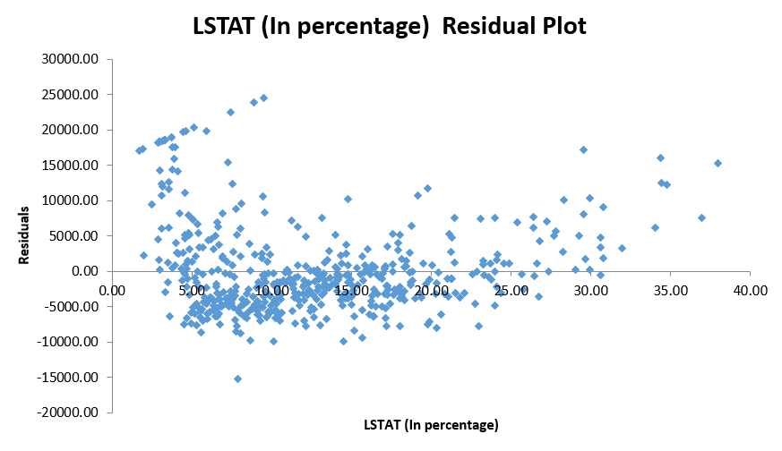
Residual Plot

Slide 13
.
B) Is LSTAT Variable Significant for the analysis –
We can say that the LSTAT variable is significant for the analysis as the Significance value is acceptable as highlighted in the regression model there will be some variations after predicting the price but not much as the P value is acceptable too but we can look for more variabels that may get good R Square value . We can see the predicted values in the residuals table .

Slide 14
Answer 6 -
In Question 6 it was asked to Build a new Regression model including LSTAT and AVG_ROOM together as Independent variables and AVG_PRICE as dependent variable .
Write the Regression equation. If a new house in this locality has 7 rooms (on an average) and has a value of 20 for L-STAT, then what will be the value of AVG_PRICE? How does it compare to the company quoting a value of 30000 USD for this locality? Is the company Overcharging/ Undercharging ?

Slide 15
.
Regression Equation would be as follows –
Average Price (Y) = Intercept + B1 (Coefficient AVG room)* X1 ( Value of AVG room)+ B2 (Coefficient (LSTAT)* X2 ( Value LSTAT) .
Through this equation we computed the value of Average Price that is 21458 . (Highlighted in the model)
The company is charging 30000 USD For this Locality . Clearly we can se that the company is overcharging according to this model as the value we computed is less than the actual charge of the company .

Slide 16
.
2. Is the performance of this model better than the previous model you built in Question 5? Compare in terms of adjusted R-square and explain.
YES, the performance of this model is better than the model we build in Question 5 as the Value of Adjusted R-Square in this Model is more (0.64) than the previous model (0.54)
The model that we build previously only 54% of variation in the average price can be explained by the LSTAT but in this model 64% of the variation in average price an be explained by LSTAT and Average Rooms .

Slide 17
Answer 7
In Question 7 it was asked to Build Regression model with all variables where AVG_PRICE alone be the Dependent Variable and all the other variables are independent. Interpret the output in terms of adjusted R-square, coefficient and Intercept values. Explain the significance of each independent variable with respect to AVG_PRICE .
In this regression model we can see that the Adjusted R-Square value is quite good that is 0.688 So the out put of this model is somewhat predictable .
I have done the output prediction in the Answer 7(1) sheet (excel) . I have predicted the average price using this model .

Slide 18
.
There were some variations in the predictions but not much .
SIGNIFICANCE –
Every variable is having same significance value that is 0.00 (Good significance value) Except –
Crime Rate – 0.53 (Not acceptable should not cross 0.05)
Indus – 0.04 (acceptable Significance value)
AGE – 0.01 ( Good significance value )
NOX – 0.01 ( Good significance value )
The significance value should not cross the mark of 0.05

Slide 19
Answer 8
In Question 8 it was asked to pick out only the significant variables from the previous question. Make another instance of the Regression model using only the significant variables you just picked and answer the questions below –
I picked every variables except Crime Rate because as we saw in the previous question its value was not significant .
Interpret the output of this model.
I have predicted the output of this model in Answer 8(a) sheet .
Average price is predicted by using this model .

Slide 20
.
Compare the adjusted R-square value of this model with the model in the previous question, which model performs better according to the value of adjusted R-square?
The Adjusted R-square value of previous model is 0.688 and the Adjusted R-Square value of this model is 0.689 . There is a very minute difference int both of the model’s Adjusted R-square value .
This model’s R-square value is a bit higher so this model performs slightly better according to the Adjusted R-Square value .

Slide 21
.
c) Sort the values of the Coefficients in ascending order. What will happen to the average price if the value of NOX is more in a locality in this town?
Sorting of the coefficients has be done in a different sheet Answer 8(c)
So, if we value of NOX is more in a locality in this town the average price is likely to be decreased we can see this through the value of the coefficients (its in negative)

Slide 22
.
d) Write the regression equation from this model –
Regression equation for this model would be –
Average price(y) = Intercept + B1(Coefficient AGE)*X1 + B2(Coefficient AVG Room)*X2 + B3(Coefficient of LSTAT)*X3 + B4(Coefficient of Distance)*X4 + B5(Coefficient of Tax)*X5 + B6(Coefficient of PT Ratio)*X6 + B7(Coefficient of Indus)*X7 + B8(Coefficient of NOX)*X8

Slide 23
.
Values of X
X1 – AGE Value
X2 – Average Room Value
X3 – LSTAT Value
X4 – Distance Value
X5 – Tax Value
X6 – PT Ratio
X7 – Indus Value
X8 – Nox Value

